Slide 1
Fee Management System
Submitted to:-
Mr. Munish Bansal
Lecturer, CSE
Submitted by:-
Vinay Kumar Prashar
6233/15
Vivek Kumar Shukla
6235/15

Slide 2
INTRODUCTION
This Fee Management System is designed and implemented in such as way that taking student attendance in a class is done in a more effective way.
The system is based on inserting and viewing attendance of students.
We can even store information of students.

Slide 3
Academic record of students is also stored in this system.
List of visitors for admission purpose is also stored using this system.
This system mainly works for making almost every work of college computerized.

Slide 4
FEATURES
Members can log in to the system by providing valid id, i.e. username and password.
Administrator can add new teachers and students.
Teachers can add and view the attendance details of students.
Students can find details of their attendance for every day and check if they are detained or not.

Slide 5
Teachers can add marks of students and students can view those marks at any time.
Time table can be added to be later viewed by teachers or students.
List of visitors, interested in admission is stored and can be viewed later to check their update.

Slide 6
MODULES
Admin : An administrator has complete access over the entire system after logging in with a valid username and password. The admin can add new teachers and students as well as delete the accounts of present teachers and students.
Admin is the main controller of this system.

Slide 7
Teacher : A teacher can insert and view attendance of students, for this the teacher need to log in with a valid ID.
Teacher can insert and view marks of students.
Student : A student can only view his/her attendance and check if he/she is detained or not from his/het valid ID.
Student can also check for their marks.

Slide 8
PLATFORMS
Front end : Java
Back end : JDBC
Database : MySQL

Slide 9
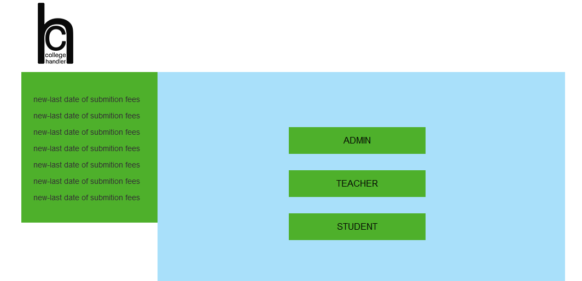
HOME PAGE

Slide 10
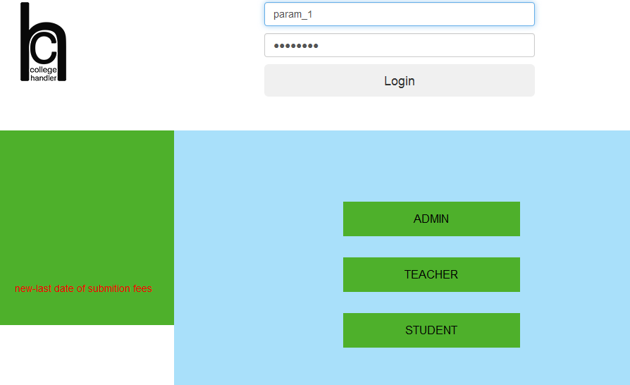
ADMIN LOGIN

Slide 11
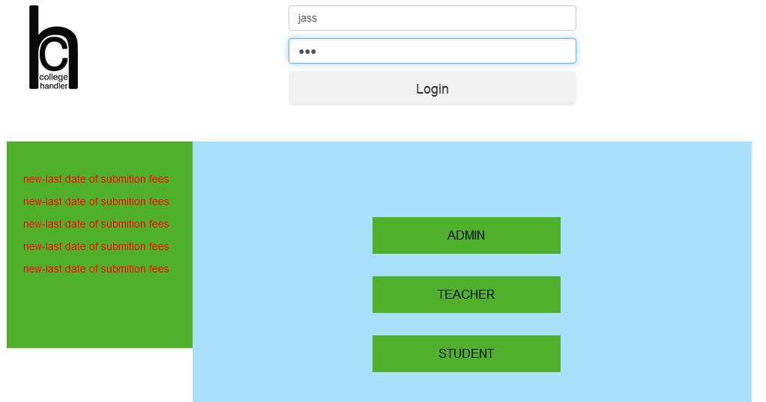
TEACHER LOGIN

Slide 12

STUDENT LOGIN

Slide 13
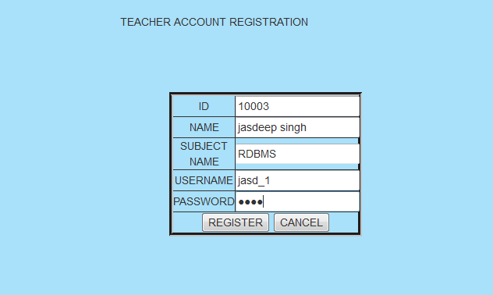
TEACHER ACCOUNT REGISTRATION

Slide 14
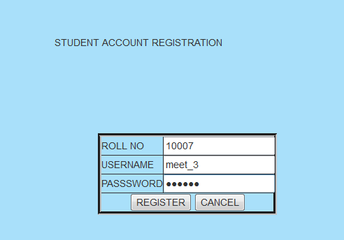
STUDENT ACCOUNT REGISTRATION

Slide 15
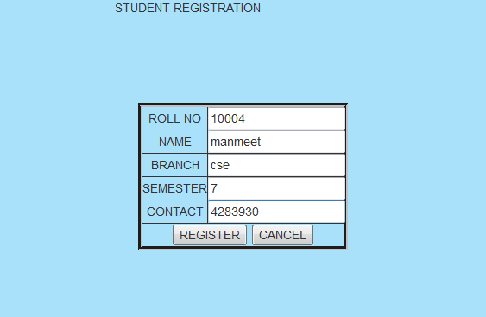
STUDENT REGISTRATION

Slide 16
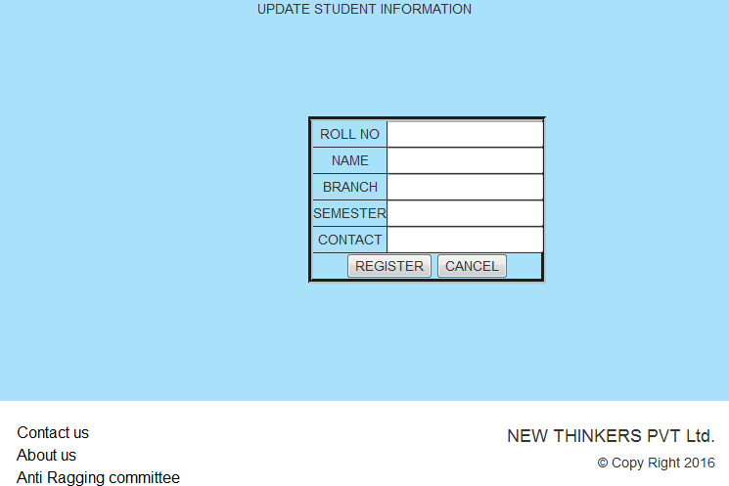
UPDATE INFORMATION

Slide 17
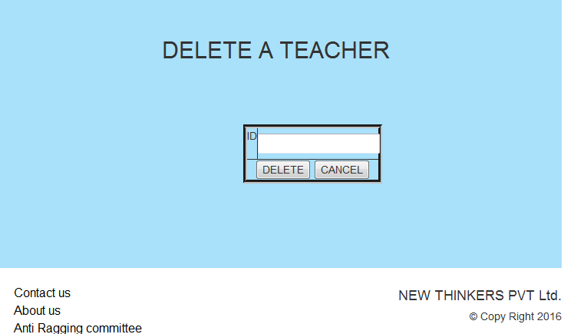
DELETE TEACHER

Slide 18
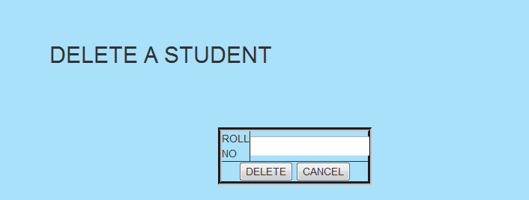
DELETE STUDENT

Slide 19
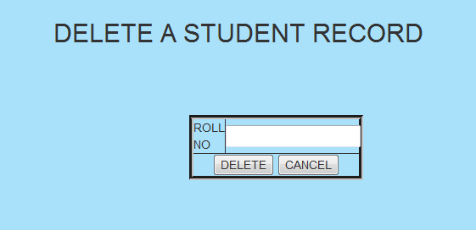
DELETE STUDENT RECORD

Slide 20
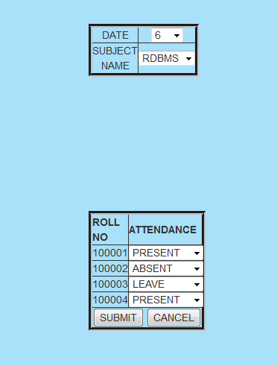
ADD ATTENDANCE

Slide 21
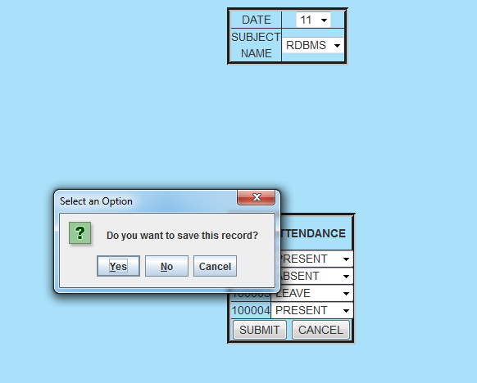
CONFIRM ADDING ATTENDANCE

Slide 22
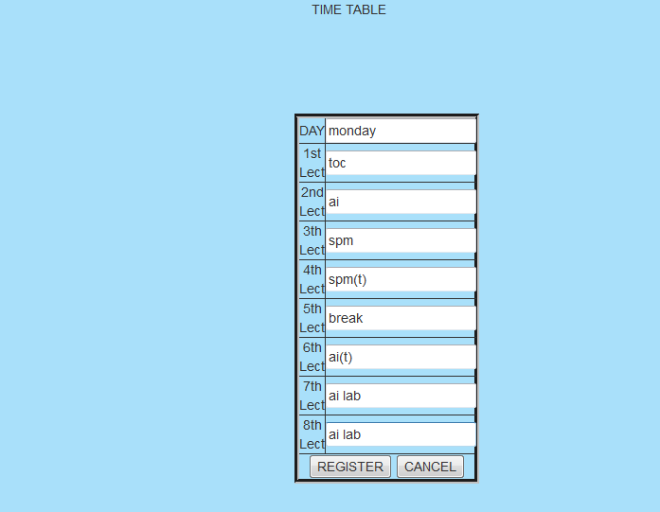
ADD TIME TABLE

Slide 23
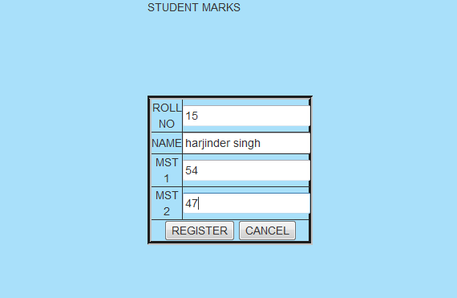
INSERT STUDENT MARKS

Slide 24
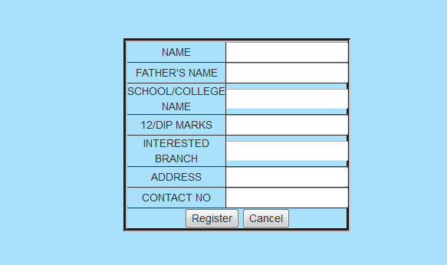
ADMISSION LIST

Slide 25
APPLICATIONS
It can be used in schools and colleges for computerizing Fee management and to store Student’s details which was done using manual methods.
It can be used in other organizations also, like corporate offices, factories, etc.
It can be used as both offline version and online versions.

Slide 26
SOFTWARE AND HARDWARE REQUIREMENTS
Hardware requirements:
Processor : Pentium
RAM : 512MB required
HARD DISK : 1GB required
Software requirements:
Eclipse
JDK
MYSQL
Tomcat

Slide 27
BIBLIOGRAPHY
Reference websites
www.javatpoint.com
www.w3schools.com
http://www.tutorialspoint.com/java/index.htm
Reference Books
Java 2.0
OCJP Certified Programmer for Java
Learn Java in Easy Steps
Complete reference Java

Slide 28
Thank you

